Slide 1
Chisel and FIRRTL for next-generation SoC designs
Jack Koenig SiFive CWG TAC Member

Slide 2
Table of Contents
Introduction
Highlights
Looking Forward

Slide 3
Introduction
What is the Chisel Working Group (CWG)?

Slide 4
What is Chisel?
Constructing Hardware In a Scala Embedded Language
Domain Specific Language where the domain is digital design
NOT high-level synthesis (HLS) nor behavioral synthesis
Write Scala program to construct and connect hardware objects
Parameterized types
Object-Oriented Programming
Functional Programming
Static Typing
Intended for writing reusable hardware generators (libraries)

Slide 5
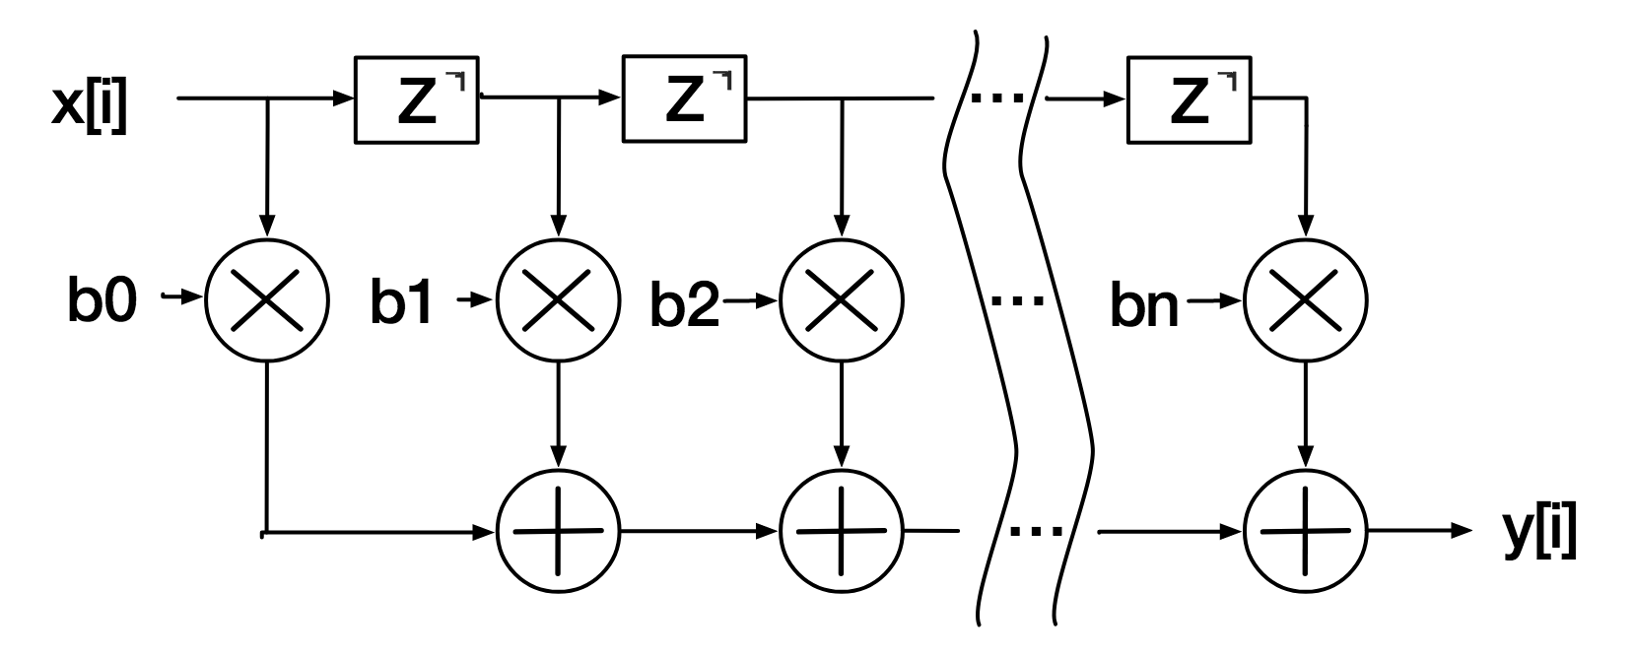
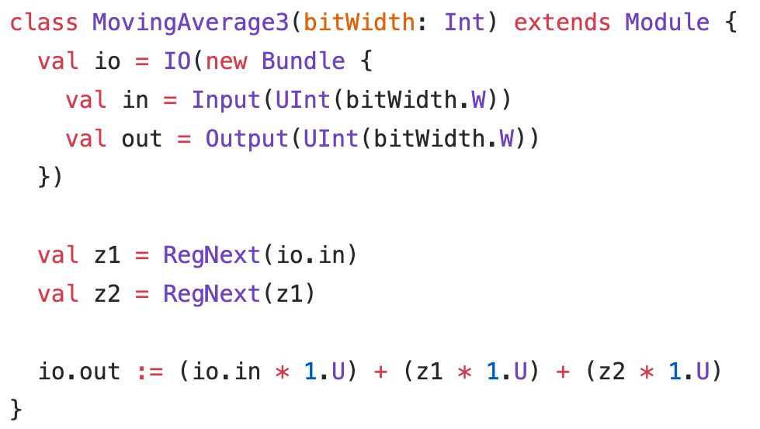
No Loss of Expressibility: “Verilog-like” Chisel
FIR Filter - 3-point moving average
What about >3 points? What about weighted averages?
We want a generic FIR filter!

Slide 6
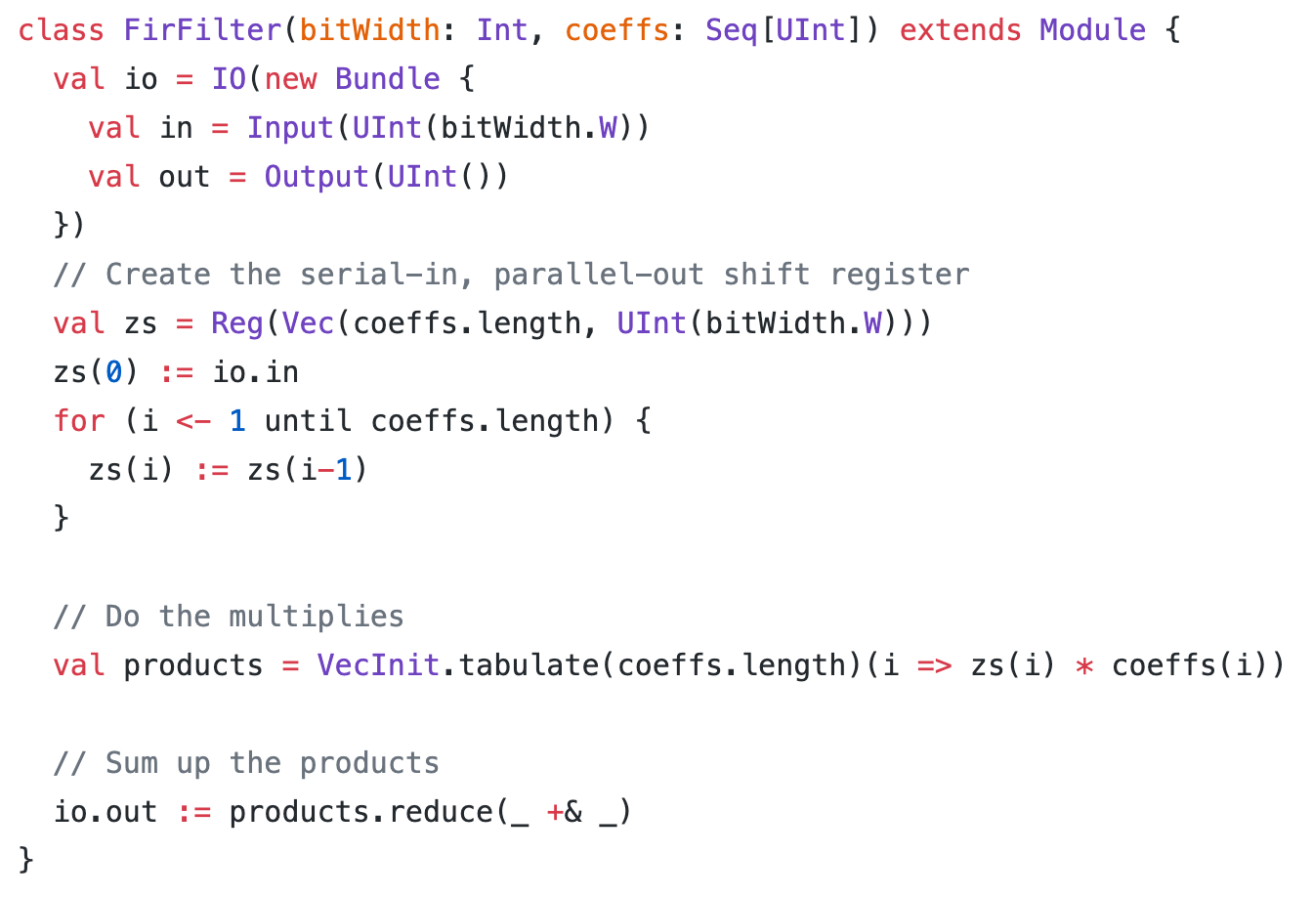
Massive Increase in Parameterizability: “Software-like” Chisel
FIR Filter - Parameterized by bitwidth and coeffients with no loss of expressibility or performance.
Meta-programming enables powerful parameterization.

Slide 7
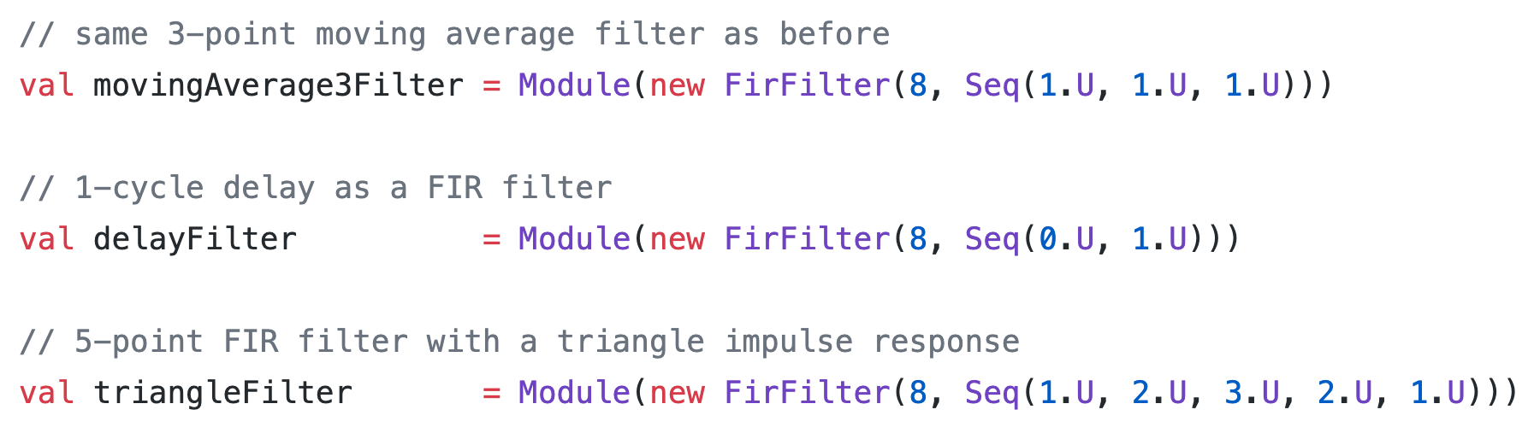
Massive Increase in Parameterizability: “Software-like” Chisel
FIR Filter - Parameterized by bitwidth and coeffients with no loss of expressibility or performance.
Meta-programming enables powerful parameterization.

Slide 8
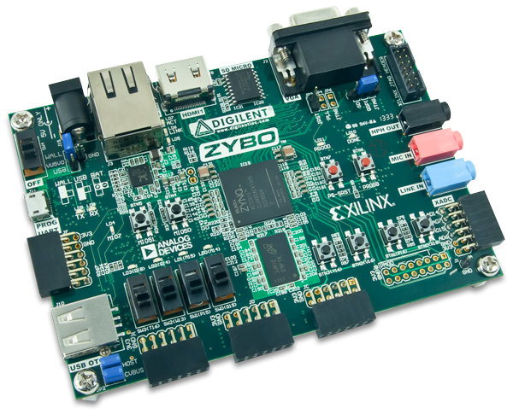
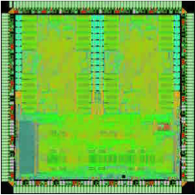
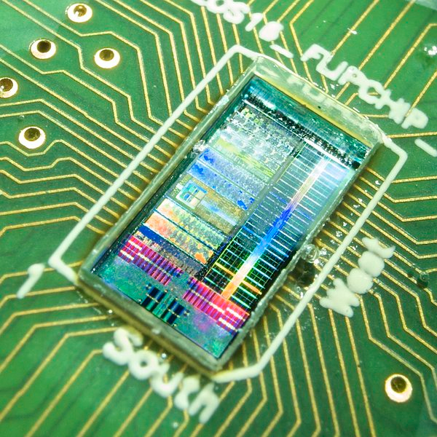
Platform-Specific or Application-Specific RTL Changes
Chip RTL
+ scan interface
+ snapshotting
+ interactive debug
+ SRAM macros
+ modified module hierarchy
+ specialized layout
+ clock-generators
+ SRAMs with init
+ specialized layout
Zynq FPGA
ST 28nm FDSOI
IBM 45nm SOI
8

Slide 9



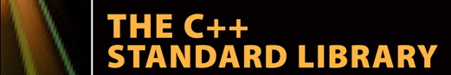




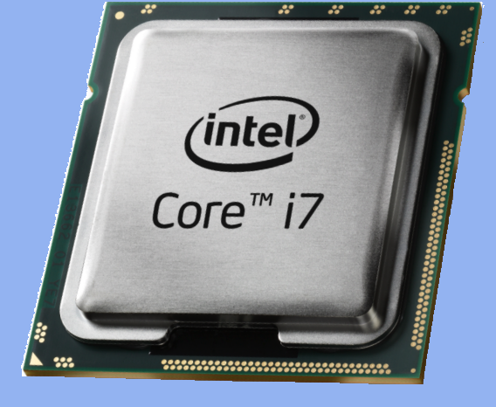
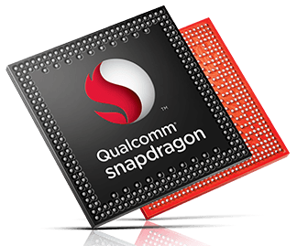
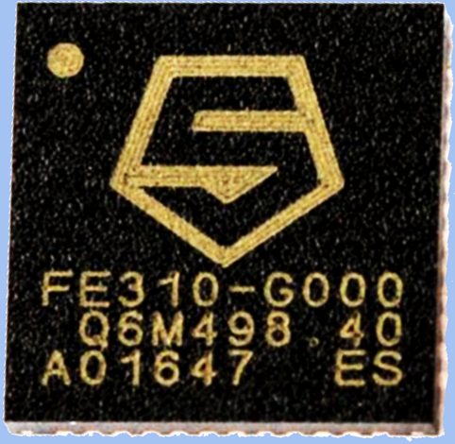

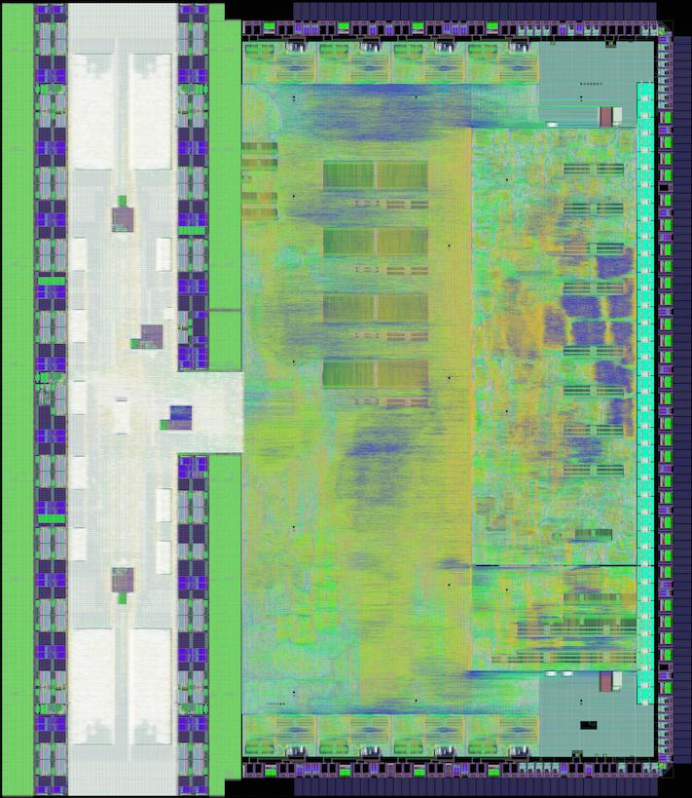



Realization: We need a software stack, but for hardware
projects
BOOM
Rocket
Hwacha
libraries
rocketchip
chisel-utils
language
compiler
clang
Chisel Frontend
transforms
FIRRTL
x86
ARM
RISC-V
platforms
Notes:
Reminder that Aliaksei pointed out that we emit Verilog and there’s “the rest of the owl” beneath that (unlike what LLVM emits), important shout outs to Verilator, Open FPGA and OpenROAD for doing the hard work of making Verilog useful.

Slide 10
FIRRTL: An Extensible Hardware Compiler Framework
Core
Transform
Custom
Transform
Top
Top
Top
MyMux
MyMux
MyMux
...
...
...
...
...
...
Metadata
Metadata
Metadata
Annotations
Annotations
Annotations
Modular Compiler Passes (Transforms)
Robust Metadata/Annotations Support

Slide 11
Projects of the Chisel Working Group
Chisel 3
FIRRTL
ChiselTest (formerly Chisel Testers 2)
Treadle
Chisel IOTesters
DSP Tools
Diagrammer
Chisel Bootcamp
Chisel Template
Currently a CHIPS Alliance “Sandbox” project with intent to ”Graduate”

Slide 12
Highlights
(From the last six months)

Slide 13
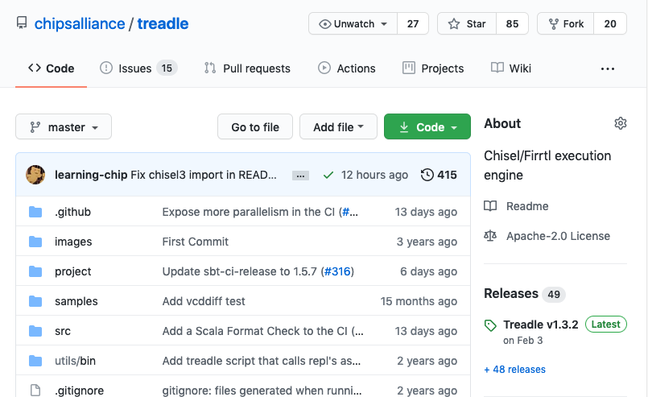
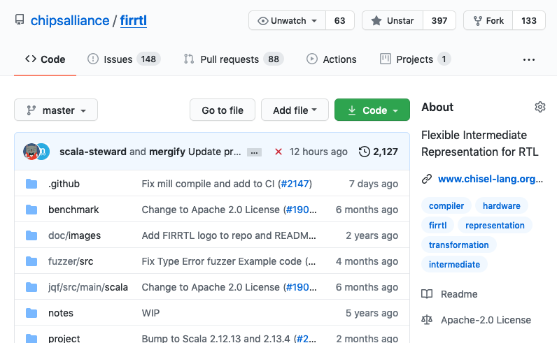
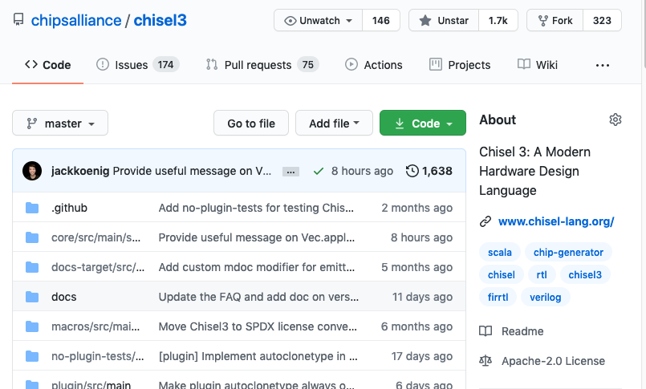
Repos moved to CHIPS Alliance Github

Slide 14
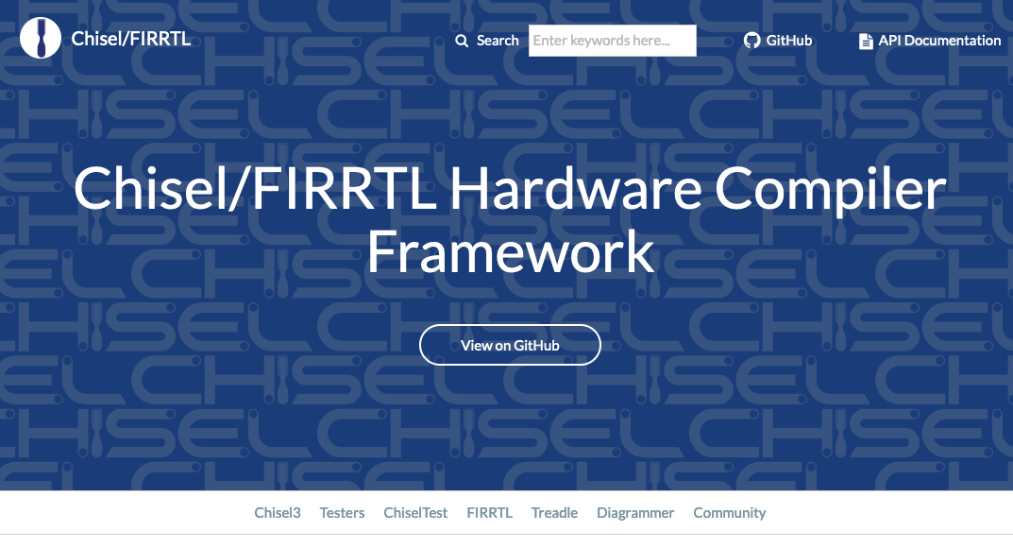
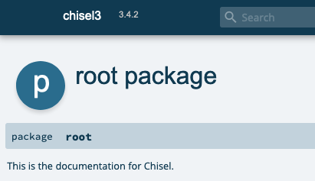
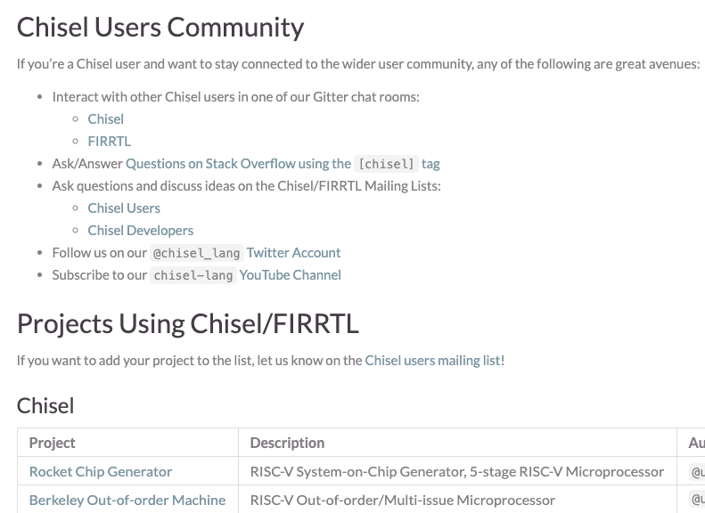
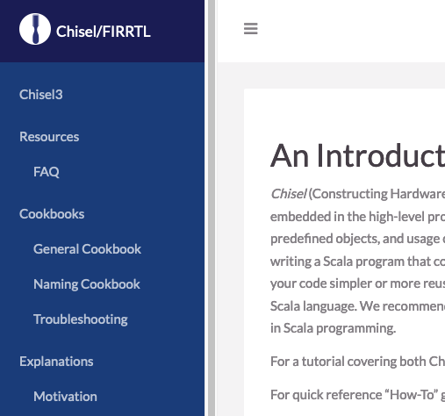
Further Improved Website
www.chisel-lang.org
Now with a search bar!
Latest API Docs
Project-specific documentation
Community page
14
3/29/21

Slide 15
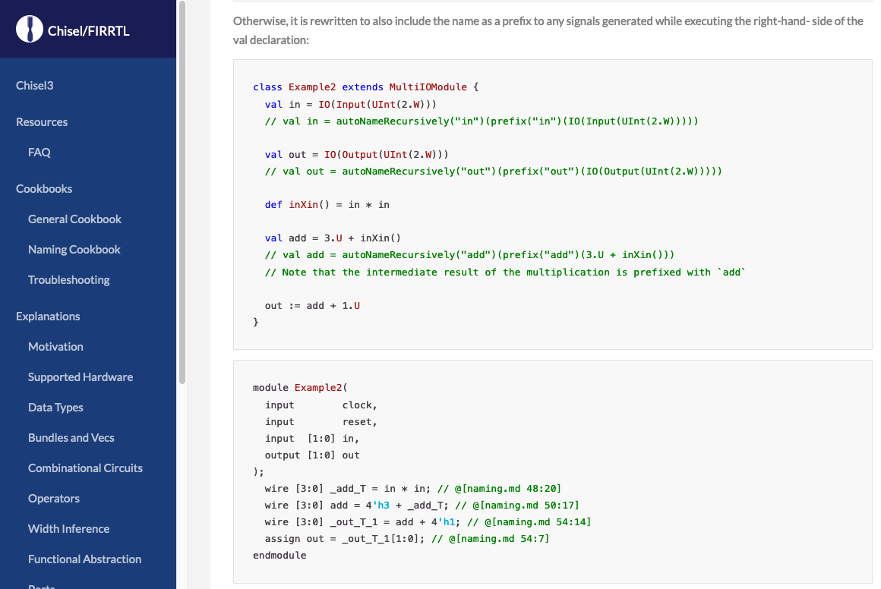
Further Improved Website
www.chisel-lang.org
Documentation examples are compiled and run!!!
15
3/29/21

Slide 16
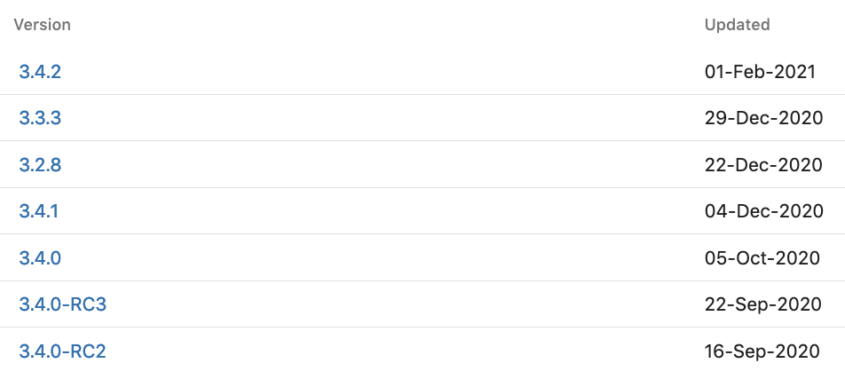
More Releases
Improved methodology started with 3.2.0
More frequent minor releases
Minor releases maintain binary compatibility
Overlapping major release branches
3.2.8 released after 3.4.1
[Still] working towards faster release cadence
SNAPSHOT releases are automatically published for every push to stable branches
Many thanks to Chick Markley and Jim Lawson at Berkeley

Slide 17
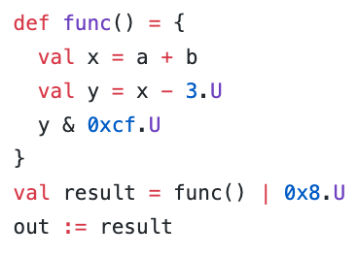
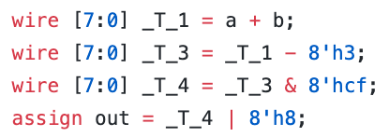
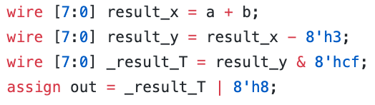
Enhanced Signal Naming (from last time)
Historically Chisel has struggled with signal naming
Chisel 3.4 has much better naming
Old* Verilog
Chisel 3.4 Verilog
Notes:
user control

Slide 18
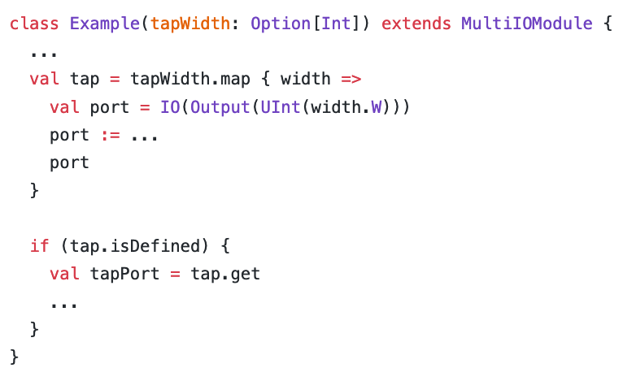
Refined Signal Naming
Optional “tap” output
What should the name of the port be?
port
tap_port
tap
tapPort
In 3.4.0, the name was ”tap_port”
In 3.4.1 on, the name is “tap”
Additional improvements to naming (especially when using recursion)
Now with ~5 months of use, it’s going great!
Notes:
user control, users are deleting their .suggestNames

Slide 19
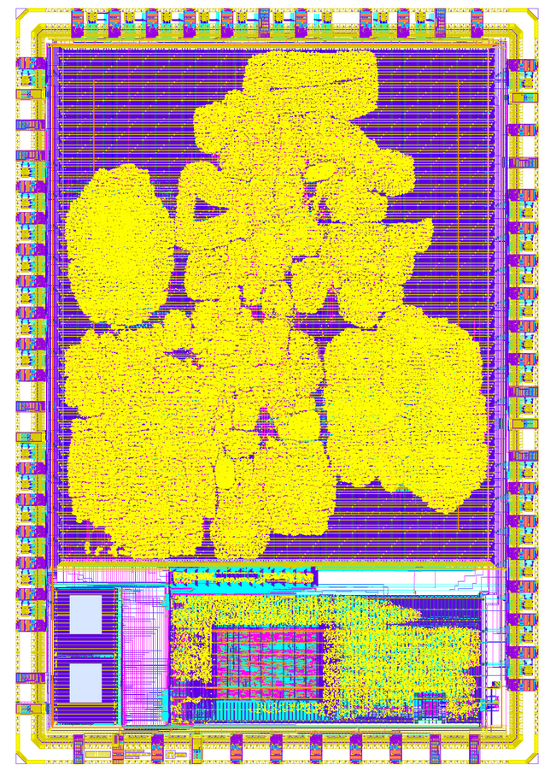
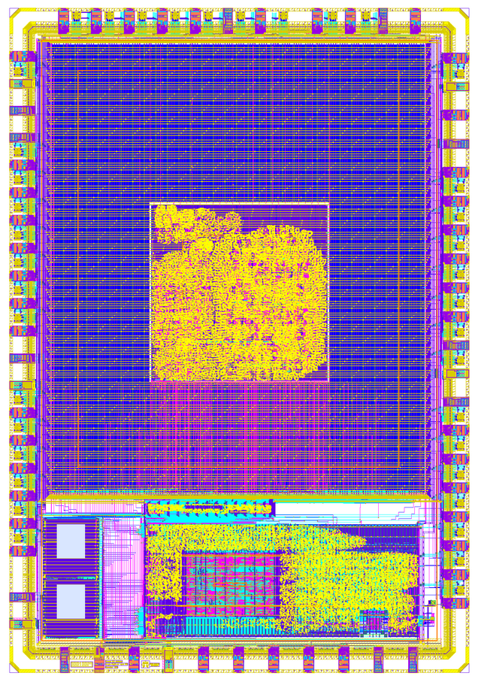
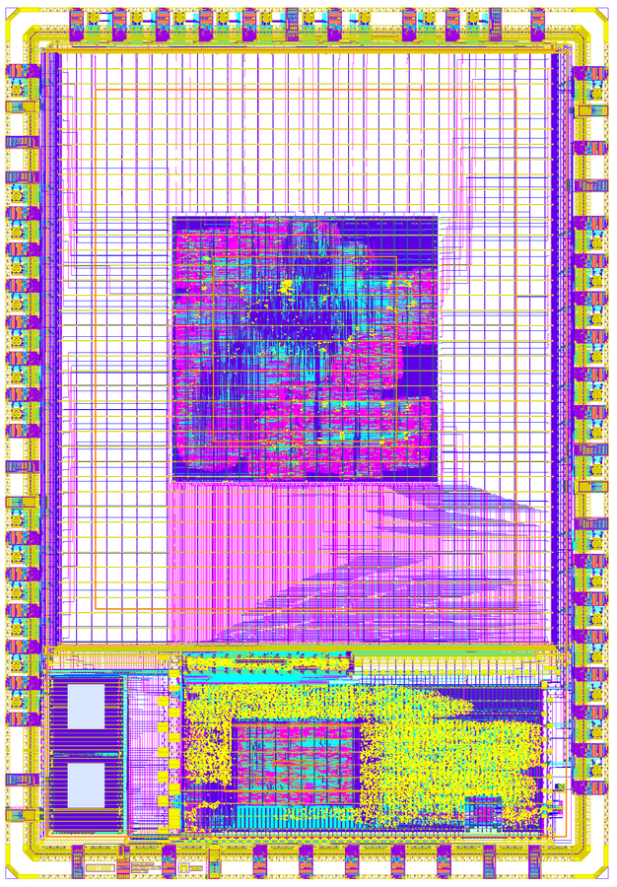
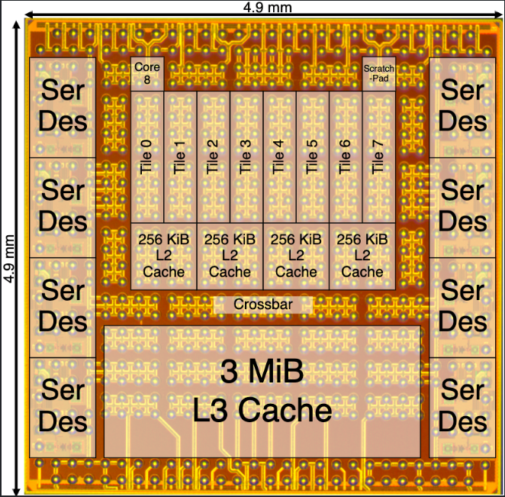
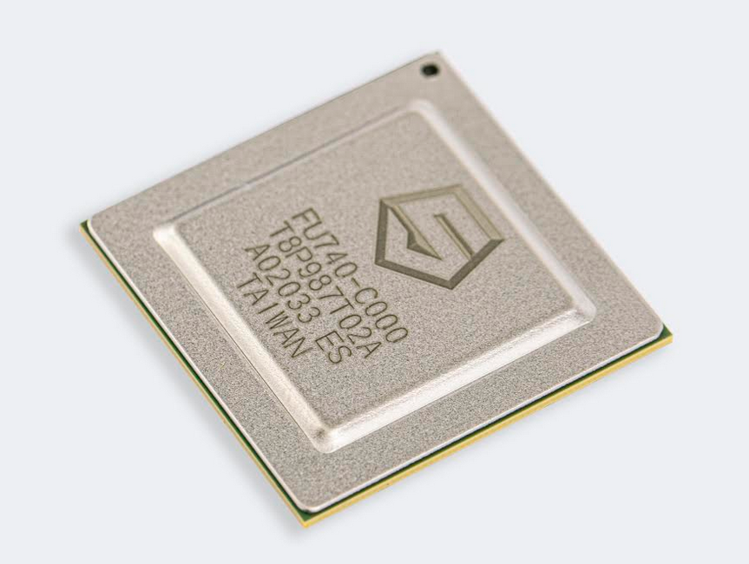
Recent Tapeouts / News
Google - Skywater - Efabless shuttle included [at least] 3 Chisel designs:
Spectrometer - https://github.com/milovanovic/spectrometer
Crypto Accelerator - https://github.com/asinghani/crypto-accelerator
Ibtida SoC - https://github.com/hadirkhan10/caravel_ibtida_soc
An Eight-Core 1.44 GHz RISC-V Vector Machine in 16nm FinFet (ISSCC)
https://ieeexplore.ieee.org/document/9365789
SiFive HiFive Unmatched
https://www.sifive.com/boards/hifive-unmatched
More? 🤷‍♂️

Slide 20
Looking Forward

Slide 21

Improved FPGA support
Chisel v3.4.4
Historically, Chisel has been used primarily for ASICs
It has been difficult to take advantage of FPGA-only features out-of-the-box
Memory initialization
Register initialization
BRAM inference
Coming --target:fpga option will box up features that improve FPGA support
Don’t forget about me!

Slide 22

AutoCloneType2
Chisel v3.4.3
I’m a TLBundle!
cloneType is an implementation detail that leaks into the user API
User-defined types need to implement it
Original AutoCloneType (aka “Reflective AutoCloneType”) works well but has some limitations
Parameters must be defined as “vals”
Works in typical use cases but not all use cases
Slow
The Chisel compiler plugin can now generate cloneType methods, with none of those limitations
.cloneType

Slide 23



DataView
Work In Progress
Often users want to manipulate hardware values as if they were a different type
AXI-style flat bus interface used as more structured hierarchy
Manipulate 1D Array of Reg as if it were 2D
Similar to a ”union” in SystemVerilog or C
Raw bits mapping may not correspond 1:1
Similar to “façade pattern” in OOP
Very boilerplate heavy
Similar to a “conversion” in Functional Programming
Conversions are immutable though, need to manipulate underlying representation
Best analogy is a “View” in SQL
Much more powerful than casts in Chisel today

Slide 24
Chisel Community Conference China 2021
WHERE: ShanghaiTech University, Pudong District, Shanghai, China
WHEN: June 25 to June 26, 2021
Co-located with first annual RISC-V Summit China
Keep an eye on https://www.chisel-lang.org/ for more details including call for submissions!

Slide 25
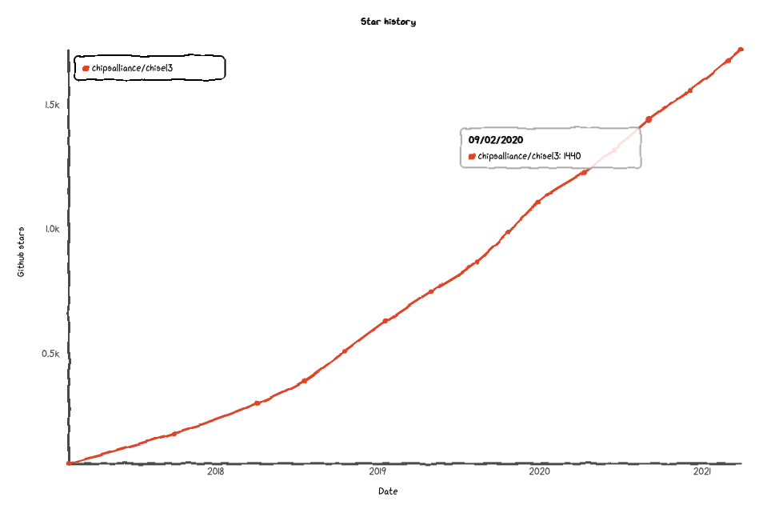
What Else?
Continued work on verification
Experimental SMT Backend
Several projects working on formal verification
Specification
Bindings to formal checkers
Report / counterexample generation
Constrained random stimulus generation
Software-based VIPs
Better and more documentation
Scala 2.13 support slated for Chisel 3.5
Vec literals
Better connection semantics
🚀

Slide 26
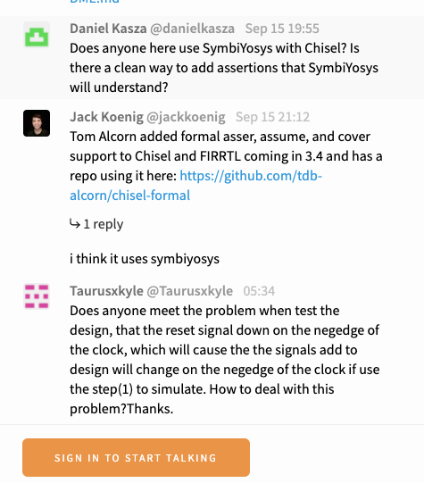
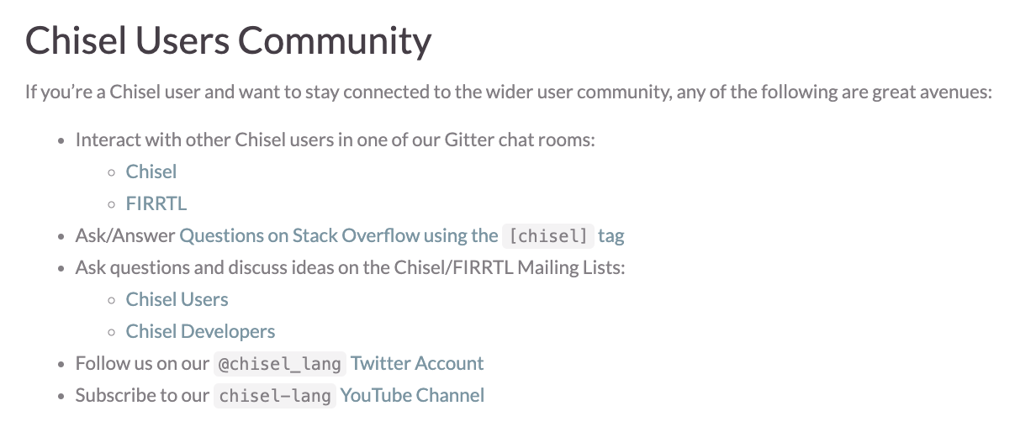
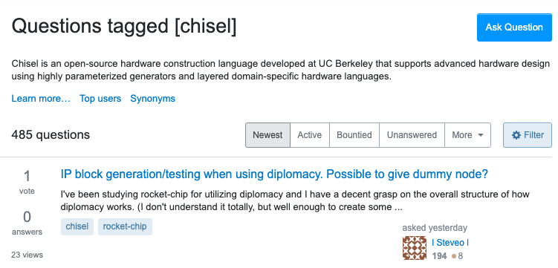
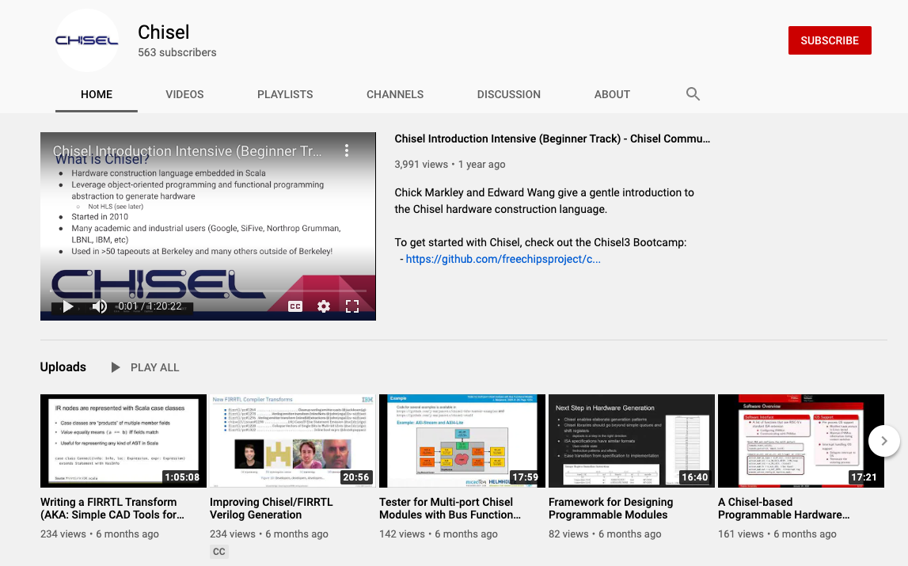
Get Involved
www.chisel-lang.org
Chat with us on Gitter
Ask questions on StackOverflow
Watch talks on YouTube

Slide 27
Extra Slides

Slide 28
Improved Release Methodology
3.2.0
3.2.1
3.2-SNAPSHOT
3.2.x
Backport
Backport
Backport
3.5-SNAPSHOT
major
major
major
master
Backport
3.3-SNAPSHOT
Automated Backporting + CI
3.3.0
3.3.x

